Slide 1
Chapter 13: Graphs II
Objectives:
Graph ADT: Operations
Graph Implementation: Data structures
Graph Traversals: DFS and BFS
Directed graphs
Weighted graphs
Shortest paths
Minimum Spanning Trees (MST)
CSC311: Data Structures

Slide 2
Weighted Graphs
In a weighted graph, each edge has an associated numerical value, called the weight of the edge
Edge weights may represent distances, costs, etc.
Example:
  In a flight route graph, the weight of an edge represents the distance in miles between the endpoint airports
849
PVD
1843
ORD
142
SFO
802
LGA
1743
1205
337
1387
HNL
2555
1099
LAX
1233
DFW
1120
MIA
Graphs II
CSC311: Data Structures

Slide 3
Shortest Paths
Given a weighted graph and two vertices u and v, we want to find a path of minimum total weight between u and v.
  Length of a path is the sum of the weights of its edges.
Example:
  Shortest path between Providence and Honolulu
Applications
  Internet packet routing
  Flight reservations
  Driving directions
849
PVD
1843
ORD
142
SFO
802
LGA
1743
1205
337
1387
HNL
2555
1099
LAX
1233
DFW
1120
MIA
Graphs II
CSC311: Data Structures

Slide 4
Shortest Path Properties
Property 1:
A subpath of a shortest path is itself a shortest path
Property 2:
There is a tree of shortest paths from a start vertex to all the other vertices
Example:
Tree of shortest paths from Providence
849
PVD
1843
ORD
142
SFO
802
LGA
1743
1205
337
1387
HNL
2555
1099
LAX
1233
DFW
1120
MIA
Graphs II
CSC311: Data Structures

Slide 5
Dijkstra’s Algorithm
We grow a “cloud” of vertices, beginning with s and eventually covering all the vertices
We store with each vertex v a label d(v) representing the distance of v from s in the subgraph consisting of the cloud and its adjacent vertices
At each step
  We add to the cloud the vertex u outside the cloud with the smallest distance label, d(u)
  We update the labels of the vertices adjacent to u
The distance of a vertex v from a vertex s is the length of a shortest path between s and v
Dijkstra’s algorithm computes the distances of all the vertices from a given start vertex s
Assumptions:
  the graph is connected
  the edges are undirected
  the edge weights are nonnegative
Graphs II
CSC311: Data Structures

Slide 6
Edge Relaxation
Consider an edge e = (u,z) such that
  u is the vertex most recently added to the cloud
  z is not in the cloud
The relaxation of edge e updates distance d(z) as follows:
d(z) ← min{d(z),d(u) + weight(e)}
d(u) = 50
10
d(z) = 75
u
e
s
z
d(u) = 50
10
d(z) = 60
u
e
s
z
Graphs II
CSC311: Data Structures

Slide 7
Example
0
0
8
A
4
8
A
4
2
2
8
7
2
1
4
8
7
2
1
3
B
C
D
B
C
D
∞
3
9
∞
3
9
2
5
5
8
E
F
2
E
F
5
0
0
8
A
4
8
A
4
2
2
8
7
2
1
3
7
7
2
1
3
B
C
D
B
C
D
5
3
9
11
5
3
9
8
2
E
F
5
2
E
F
5
Graphs II
CSC311: Data Structures

Slide 8
Example (cont.)
0
8
A
4
2
7
7
2
1
3
B
C
D
5
3
9
8
2
E
F
5
0
8
A
4
2
7
7
2
1
3
B
C
D
5
3
9
8
2
E
F
5
Graphs II
CSC311: Data Structures

Slide 9
Dijkstra’s Algorithm
Algorithm DijkstraDistances(G, s)
Q ← new heap-based priority queue
for all v ∈ G.vertices()
if v = s
setDistance(v, 0)
else
setDistance(v, ∞)
l ← Q.insert(getDistance(v), v)
  setLocator(v,l)
  while ¬Q.isEmpty()
  u ← Q.removeMin()
  for all e ∈ G.incidentEdges(u)
  { relax edge e }
  z ← G.opposite(u,e)
  r ← getDistance(u) + weight(e)
  if r < getDistance(z)
  setDistance(z,r)
  Q.replaceKey(getLocator(z),r)
A priority queue stores the vertices outside the cloud
  Key: distance
  Element: vertex
Locator-based methods
  insert(k,e) returns a locator
  replaceKey(l,k) changes the key of an item
We store two labels with each vertex:
  Distance (d(v) label)
  locator in priority queue
Graphs II
CSC311: Data Structures

Slide 10
Analysis of Dijkstra’s Algorithm
Graph operations
  Method incidentEdges is called once for each vertex
Label operations
  We set/get the distance and locator labels of vertex z O(deg(z)) times
  Setting/getting a label takes O(1) time
Priority queue operations
  Each vertex is inserted once into and removed once from the priority queue, where each insertion or removal takes O(log n) time
  The key of a vertex in the priority queue is modified at most deg(w) times, where each key change takes O(log n) time
Dijkstra’s algorithm runs in O((n + m) log n) time provided the graph is represented by the adjacency list structure
  Recall that Σ_{v} deg(v) = 2m
The running time can also be expressed as O(m log n) since the graph is connected
Graphs II
CSC311: Data Structures

Slide 11
Shortest Paths Tree
Using the template method pattern, we can extend Dijkstra’s algorithm to return a tree of shortest paths from the start vertex to all other vertices
We store with each vertex a third label:
  parent edge in the shortest path tree
In the edge relaxation step, we update the parent label
Algorithm DijkstraShortestPathsTree(G, s)
  …
for all v ∈ G.vertices()
  …
setParent(v, ∅)
  …
  for all e ∈ G.incidentEdges(u)
  { relax edge e }
  z ← G.opposite(u,e)
  r ← getDistance(u) + weight(e)
  if r < getDistance(z)
  setDistance(z,r)
  setParent(z,e)
  Q.replaceKey(getLocator(z),r)
Graphs II
CSC311: Data Structures

Slide 12
Why Dijkstra’s Algorithm Works
Dijkstra’s algorithm is based on the greedy method. It adds vertices by increasing distance.
  Suppose it didn’t find all shortest distances. Let F be the first wrong vertex the algorithm processed.
  When the previous node, D, on the true shortest path was considered, its distance was correct.
  But the edge (D,F) was relaxed at that time!
  Thus, so long as d(F)>d(D), F’s distance cannot be wrong. That is, there is no wrong vertex.
0
8
A
4
2
7
7
2
1
3
B
C
D
5
3
9
8
2
E
F
5
Graphs II
CSC311: Data Structures

Slide 13
Why It Doesn’t Work for Negative-Weight Edges
Dijkstra’s algorithm is based on the greedy method. It adds vertices by increasing distance.
0
  If a node with a negative incident edge were to be added late to the cloud, it could mess up distances for vertices already in the cloud.
A
4
8
6
7
7
5
1
4
B
C
D
5
0
-8
9
2
E
F
5
C’s true distance is 1, but it is already in the cloud with d(C)=5!
Graphs II
CSC311: Data Structures

Slide 14
Bellman-Ford Algorithm
Works even with negative-weight edges
Must assume directed edges (for otherwise we would have negative-weight cycles)
Iteration i finds all shortest paths that use i edges.
Running time: O(nm).
Can be extended to detect a negative-weight cycle if it exists
  How?
Algorithm BellmanFord(G, s)
for all v ∈ G.vertices()
if v = s
setDistance(v, 0)
else
setDistance(v, ∞)
for i ← 1 to n-1 do
  for each e ∈ G.edges()
  { relax edge e }
  u ← G.origin(e)
  z ← G.opposite(u,e)
  r ← getDistance(u) + weight(e)
  if r < getDistance(z)
  setDistance(z,r)
Graphs II
CSC311: Data Structures

Slide 15
Bellman-Ford Example
Nodes are labeled with their d(v) values
8
0
4
8
0
4
-2
-2
7
1
8
7
-2
1
4
∞
∞
∞
∞
∞
∞
3
9
3
9
-2
∞
∞
5
-2
∞
∞
5
8
0
4
8
0
4
-2
-2
5
8
7
-2
1
4
-1
5
7
-2
1
-1
1
3
9
3
9
-2
6
9
5
-2
4
5
∞
∞
1
9
Graphs II
CSC311: Data Structures

Slide 16
DAG-based Algorithm
Works even with negative-weight edges
Uses topological order
Doesn’t use any fancy data structures
Is much faster than Dijkstra’s algorithm
Running time: O(n+m).
Algorithm DagDistances(G, s)
for all v ∈ G.vertices()
if v = s
setDistance(v, 0)
else
setDistance(v, ∞)
Perform a topological sort of the vertices
for u ← 1 to n do {in topological order}
  for each e ∈ G.outEdges(u)
  { relax edge e }
  z ← G.opposite(u,e)
  r ← getDistance(u) + weight(e)
  if r < getDistance(z)
  setDistance(z,r)
Graphs II
CSC311: Data Structures

Slide 17
DAG Example
Nodes are labeled with their d(v) values
1
1
8
0
4
8
0
4
-2
-2
3
7
2
1
4
3
8
7
2
-2
1
4
4
∞
∞
∞
∞
∞
∞
3
9
3
9
-5
∞
∞
5
-5
∞
∞
5
6
5
6
5
1
1
8
0
4
8
0
4
-2
-2
3
5
7
2
1
4
-1
3
7
2
1
4
8
-2
4
5
-2
-1
3
9
3
9
-5
1
7
5
-5
0
4
5
∞
∞
1
7
6
5
6
5
Graphs II
CSC311: Data Structures
(two steps)

Slide 18
Minimum Spanning Trees
Spanning subgraph
  Subgraph of a graph G containing all the vertices of G
Spanning tree
  Spanning subgraph that is itself a (free) tree
Minimum spanning tree (MST)
  Spanning tree of a weighted graph with minimum total edge weight
Applications
  Communications networks
  Transportation networks
ORD
10
1
PIT
DEN
6
7
9
3
DCA
4
STL
8
5
2
DFW
ATL
Graphs II
CSC311: Data Structures

Slide 19
Cycle Property
f
8
Cycle Property:
  Let T be a minimum spanning tree of a weighted graph G
  Let e be an edge of G that is not in T and C let be the cycle formed by e with T
  For every edge f of C, weight(f) ≤ weight(e)
  Proof:
  By contradiction
  If weight(f) > weight(e) we can get a spanning tree of smaller weight by replacing e with f
4
C
9
2
6
3
e
8
7
7
Replacing f with e yields
a better spanning tree
f
8
4
C
9
2
6
3
e
8
7
7
Graphs II
CSC311: Data Structures

Slide 20
Partition Property
Partition Property:
  Consider a partition of the vertices of G into subsets U and V
  Let e be an edge of minimum weight across the partition
  There is a minimum spanning tree of G containing edge e
  Proof:
  Let T be an MST of G
  If T does not contain e, consider the cycle C formed by e with T and let f be an edge of C across the partition
  By the cycle property,
  weight(f) ≤ weight(e)
  Thus, weight(f) = weight(e)
  We obtain another MST by replacing f with e
U
V
f
7
4
9
2
5
8
8
e
3
7
Replacing f with e yields
another MST
U
V
f
7
4
9
2
5
8
8
e
3
7
Graphs II
CSC311: Data Structures

Slide 21
Kruskal’s Algorithm
A priority queue stores the edges outside the cloud
  Key: weight
  Element: edge
At the end of the algorithm
  We are left with one cloud that encompasses the MST
  A tree T which is our MST
Algorithm KruskalMST(G)
for each vertex V in G do
define a Cloud(v) of ← {v}
let Q be a priority queue.
Insert all edges into Q using their weights as the key
T ← ∅
while T has fewer than n-1 edges do edge e = T.removeMin()
Let u, v be the endpoints of e
if Cloud(v) ≠ Cloud(u) then
Add edge e to T
Merge Cloud(v) and Cloud(u)
return T
Graphs II
CSC311: Data Structures

Slide 22
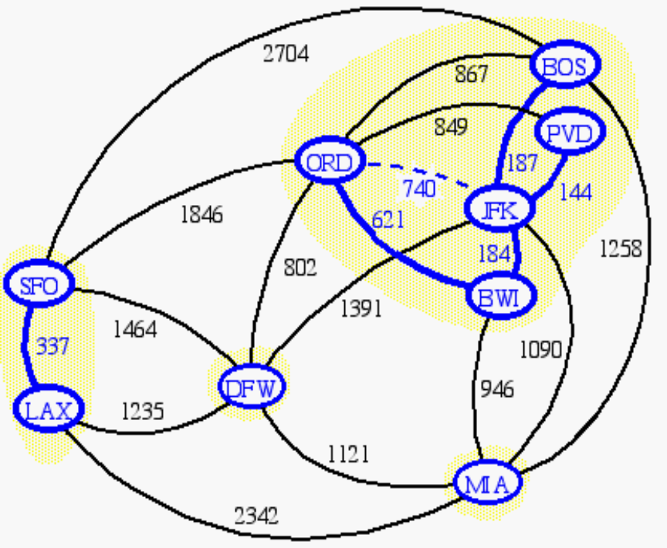
Data Structure for Kruskal Algortihm
The algorithm maintains a forest of trees
An edge is accepted it if connects distinct trees
We need a data structure that maintains a partition, i.e., a collection of disjoint sets, with the operations:
-find(u): return the set storing u
-union(u,v): replace the sets storing u and v with their union
Graphs II
CSC311: Data Structures

Slide 23
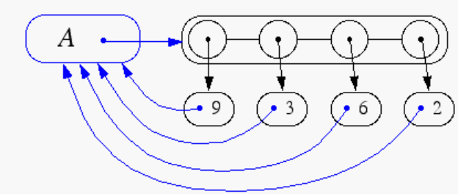
Representation of a Partition
Each set is stored in a sequence
Each element has a reference back to the set
  operation find(u) takes O(1) time, and returns the set of which u is a member.
  in operation union(u,v), we move the elements of the smaller set to the sequence of the larger set and update their references
  the time for operation union(u,v) is min(n_{u},n_{v}), where n_{u} and n_{v} are the sizes of the sets storing u and v
Whenever an element is processed, it goes into a set of size at least double, hence each element is processed at most log n times
Graphs II
CSC311: Data Structures

Slide 24
Partition-Based Implementation
A partition-based version of Kruskal’s Algorithm performs cloud merges as unions and tests as finds.
Algorithm Kruskal(G):
Input: A weighted graph G.
Output: An MST T for G.
Let P be a partition of the vertices of G, where each vertex forms a separate set.
Let Q be a priority queue storing the edges of G, sorted by their weights
Let T be an initially-empty tree
while Q is not empty do
(u,v) ← Q.removeMinElement()
if P.find(u) != P.find(v) then
Add (u,v) to T
P.union(u,v)
return T
Running time: O((n+m)log n)
Graphs II
CSC311: Data Structures

Slide 25
Kruskal Example
2704
867
BOS
849
PVD
ORD
187
740
144
1846
621
JFK
184
1258
802
SFO
BWI
1391
1464
337
1090
DFW
946
LAX
1235
1121
MIA
2342
Graphs II
CSC311: Data Structures

Slide 26
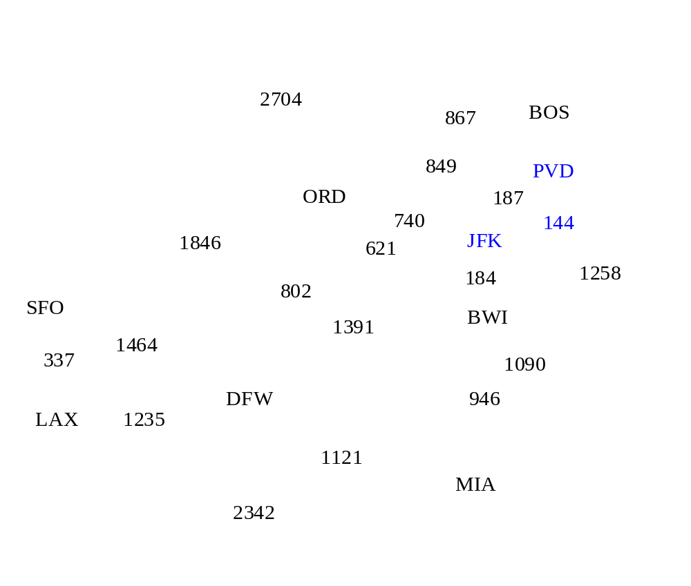
Example
Graphs II
CSC311: Data Structures

Slide 27
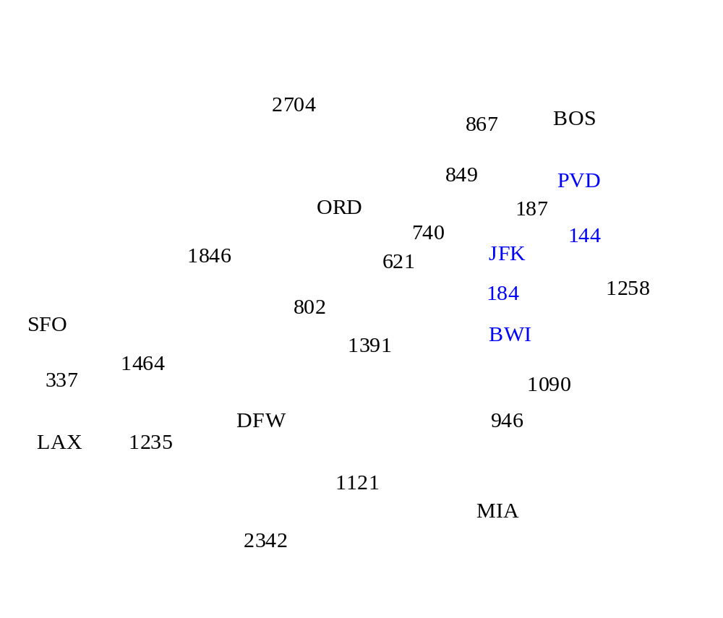
Example
Graphs II
CSC311: Data Structures

Slide 28
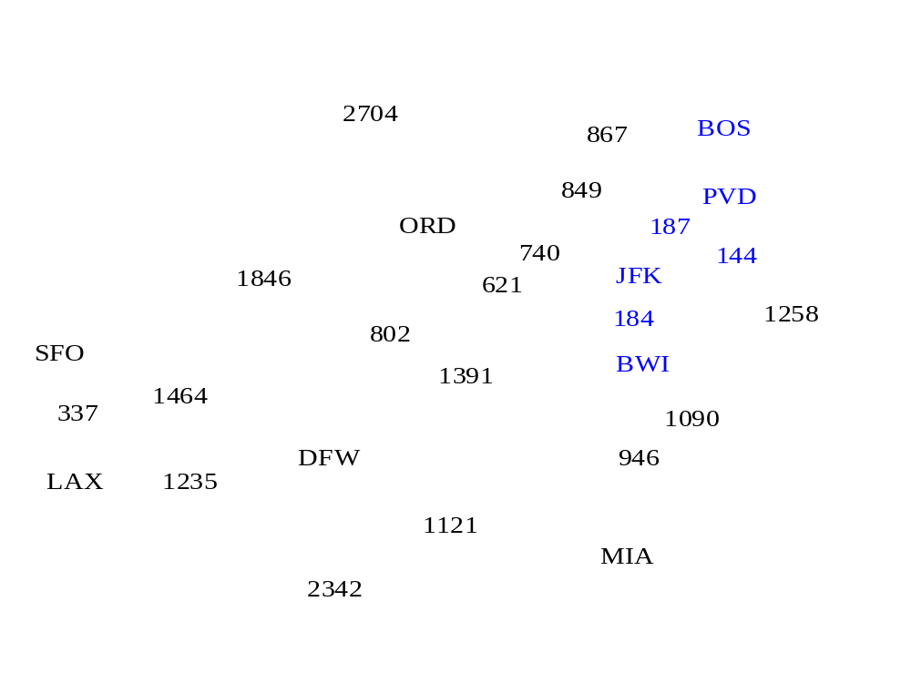
Example
Graphs II
CSC311: Data Structures

Slide 29
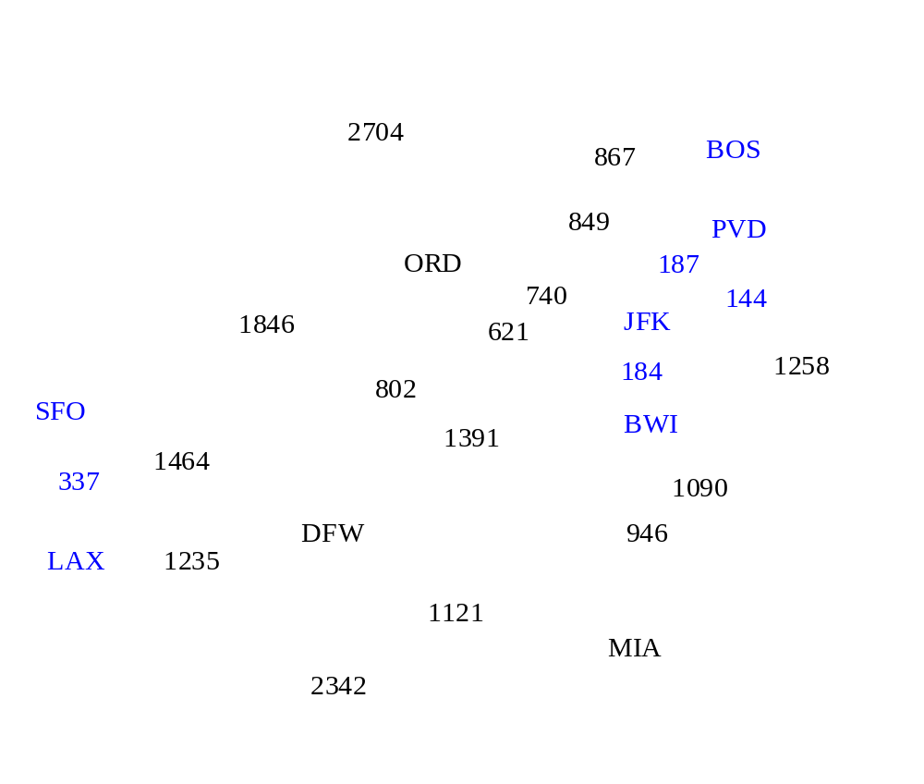
Example
Graphs II
CSC311: Data Structures

Slide 30
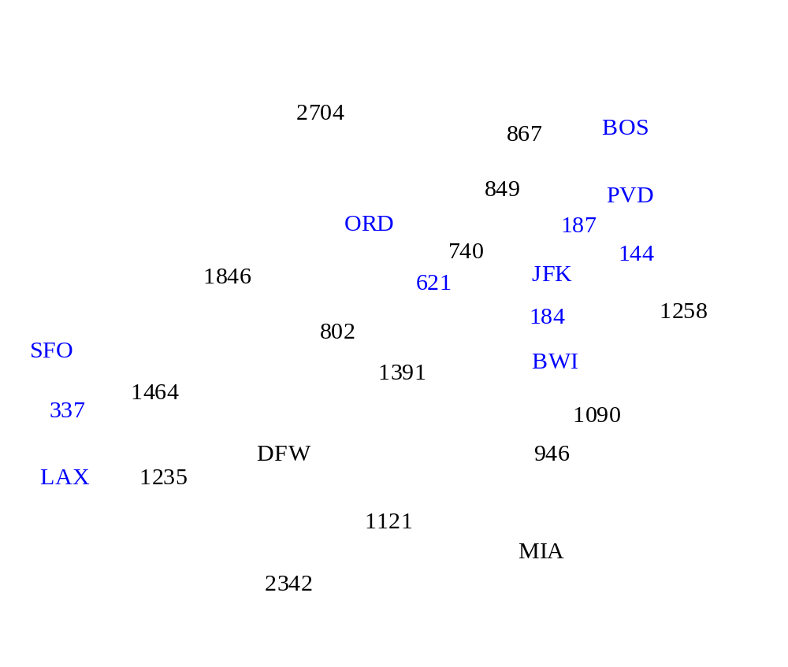
Example
Graphs II
CSC311: Data Structures

Slide 31
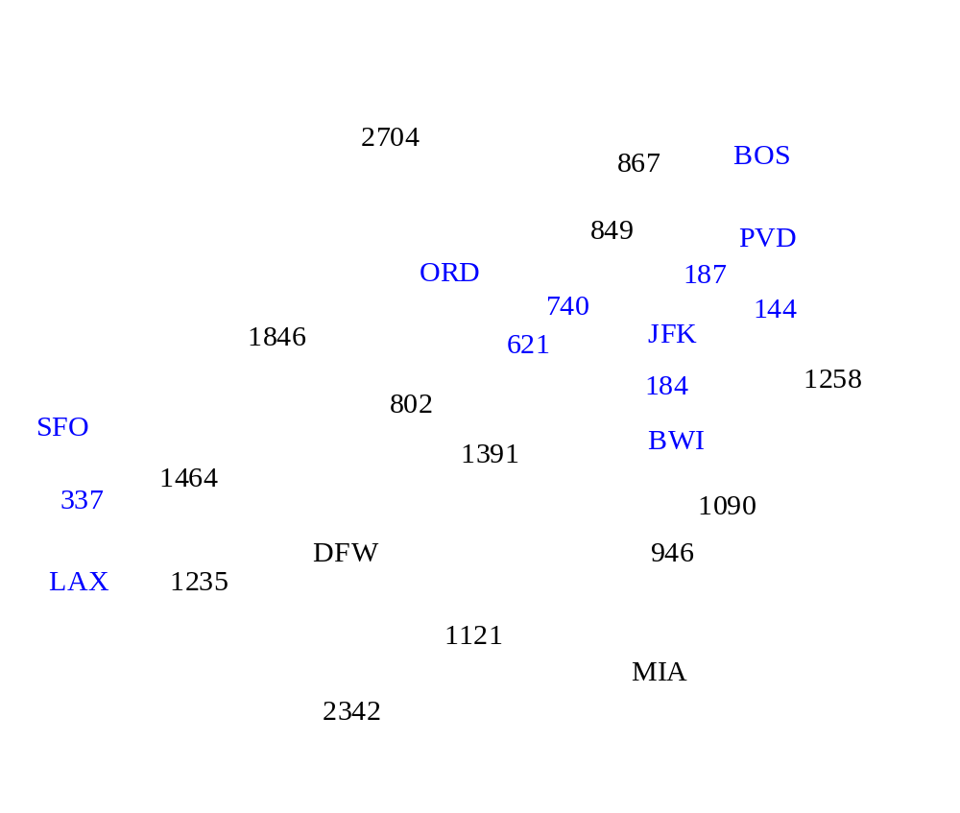
Example
Graphs II
CSC311: Data Structures

Slide 32
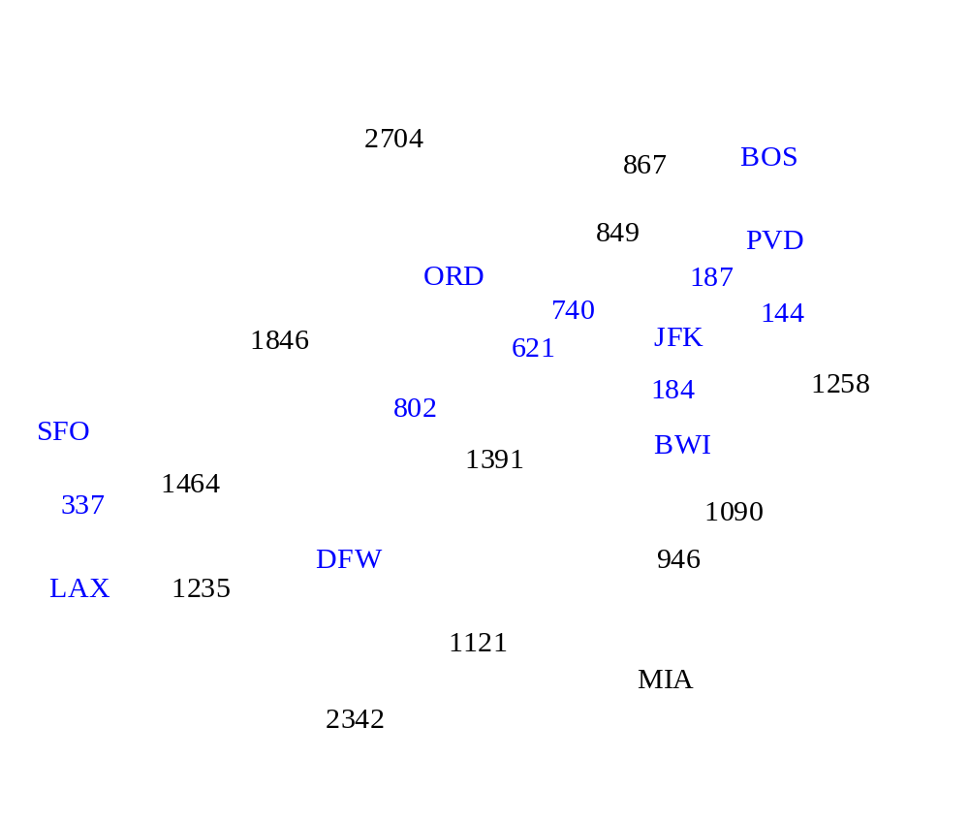
Example
Graphs II
CSC311: Data Structures

Slide 33
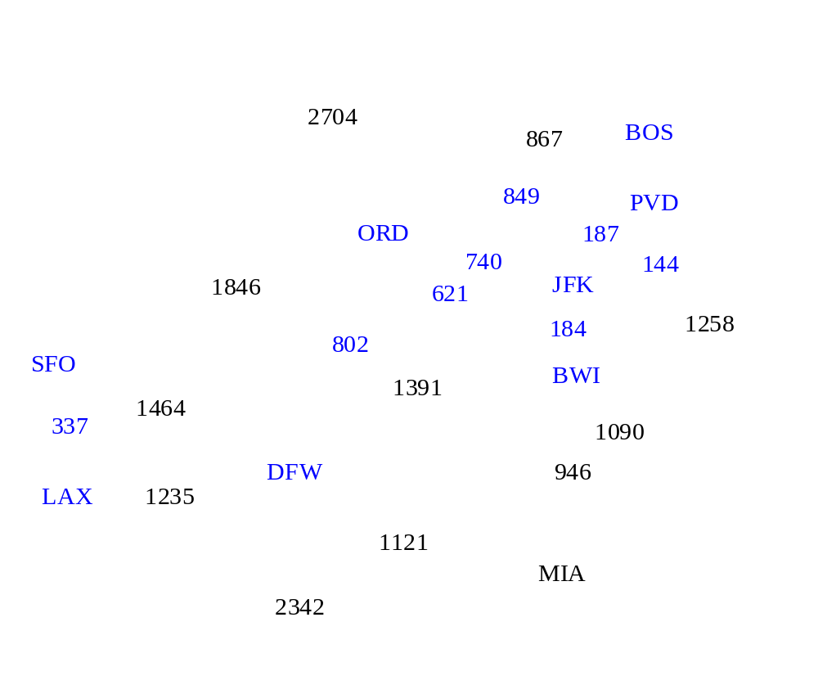
Example
Graphs II
CSC311: Data Structures

Slide 34
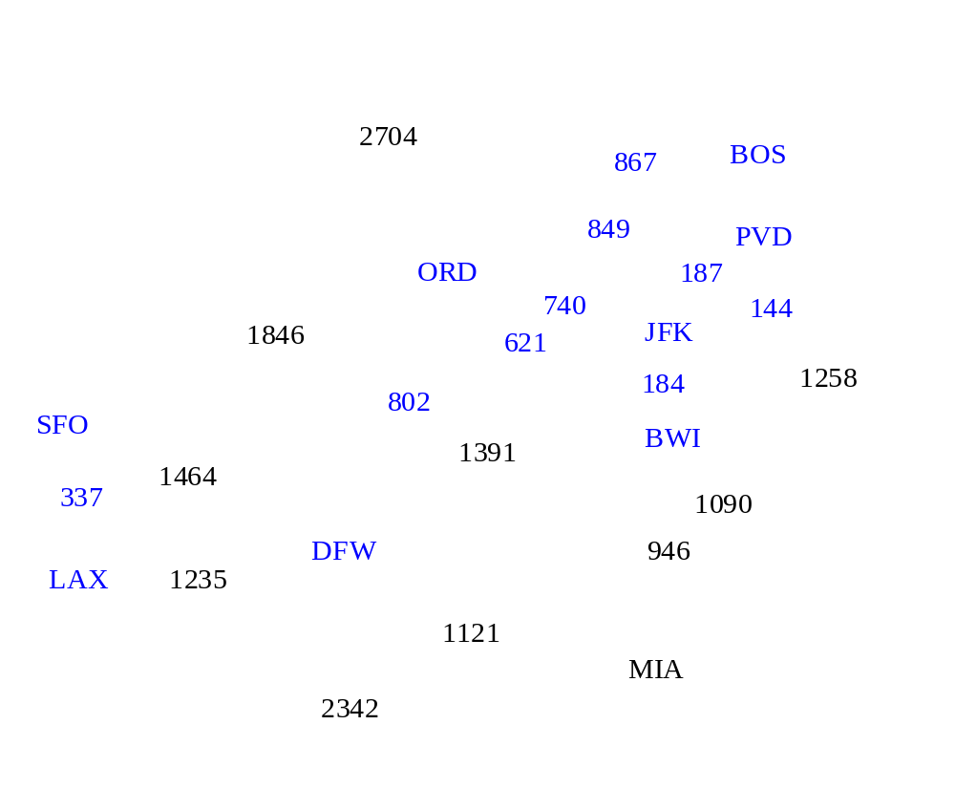
Example
Graphs II
CSC311: Data Structures

Slide 35

Example
Graphs II
CSC311: Data Structures

Slide 36
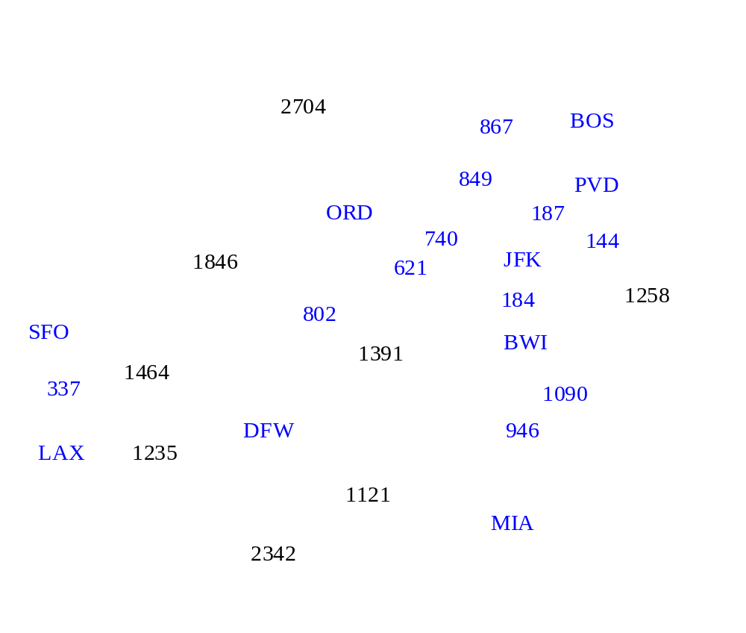
Example
Graphs II
CSC311: Data Structures

Slide 37

Example
Graphs II
CSC311: Data Structures

Slide 38
Example
2704
867
BOS
849
PVD
ORD
187
740
144
1846
621
JFK
184
1258
802
SFO
BWI
1391
1464
337
1090
DFW
946
LAX
1235
1121
MIA
2342
Graphs II
CSC311: Data Structures

Slide 39
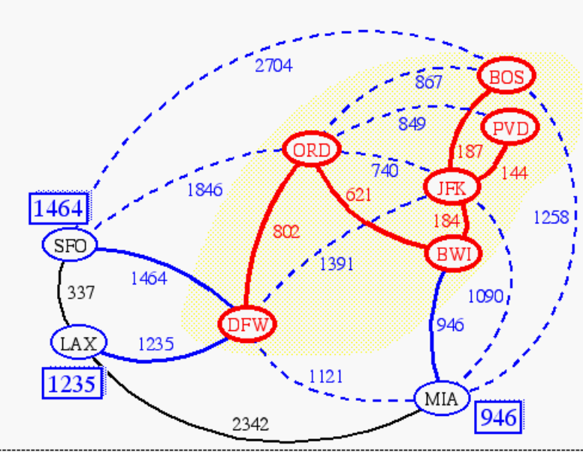
Prim-Jarnik’s Algorithm
Similar to Dijkstra’s algorithm (for a connected graph)
We pick an arbitrary vertex s and we grow the MST as a cloud of vertices, starting from s
We store with each vertex v a label d(v) = the smallest weight of an edge connecting v to a vertex in the cloud
At each step:
  We add to the cloud the vertex u outside the cloud with the smallest distance label
  We update the labels of the vertices adjacent to u
Graphs II
CSC311: Data Structures

Slide 40
Prim-Jarnik’s Algorithm
A priority queue stores the vertices outside the cloud
  Key: distance
  Element: vertex
Locator-based methods
  insert(k,e) returns a locator
  replaceKey(l,k) changes the key of an item
We store three labels with each vertex:
  Distance
  Parent edge in MST
  Locator in priority queue
Algorithm PrimJarnikMST(G)
Q ← new heap-based priority queue
s ← a vertex of G
for all v ∈ G.vertices()
if v = s
setDistance(v, 0)
else
setDistance(v, ∞)
setParent(v, ∅)
l ← Q.insert(getDistance(v), v)
  setLocator(v,l)
  while ¬Q.isEmpty()
  u ← Q.removeMin()
  for all e ∈ G.incidentEdges(u)
  z ← G.opposite(u,e)
  r ← weight(e)
  if r < getDistance(z)
  setDistance(z,r)
  setParent(z,e)
  Q.replaceKey(getLocator(z),r)
Graphs II
CSC311: Data Structures

Slide 41
Example
∞
7
2
7
D
2
7
D
B
4
B
4
8
9
∞
5
9
∞
2
5
F
2
5
F
C
8
C
8
8
3
8
3
E
E
A
7
7
A
7
7
0
0
7
7
2
7
D
7
D
B
4
2
B
4
5
9
∞
9
4
2
5
F
5
5
C
2
F
8
C
8
8
3
3
E
8
A
7
E
0
7
A
7
7
0
Graphs II
CSC311: Data Structures

Slide 42
Example (contd.)
7
2
7
D
B
4
5
9
4
2
5
F
C
8
8
3
E
A
7
3
7
0
7
D
2
B
4
5
9
4
2
5
F
C
8
8
3
E
A
7
3
0
Graphs II
CSC311: Data Structures

Slide 43
Analysis
Graph operations
  Method incidentEdges is called once for each vertex
Label operations
  We set/get the distance, parent and locator labels of vertex z O(deg(z)) times
  Setting/getting a label takes O(1) time
Priority queue operations
  Each vertex is inserted once into and removed once from the priority queue, where each insertion or removal takes O(log n) time
  The key of a vertex w in the priority queue is modified at most deg(w) times, where each key change takes O(log n) time
Prim-Jarnik’s algorithm runs in O((n + m) log n) time provided the graph is represented by the adjacency list structure
  Recall that Σ_{v} deg(v) = 2m
The running time is O(m log n) since the graph is connected
Graphs II
CSC311: Data Structures

